Slide 1
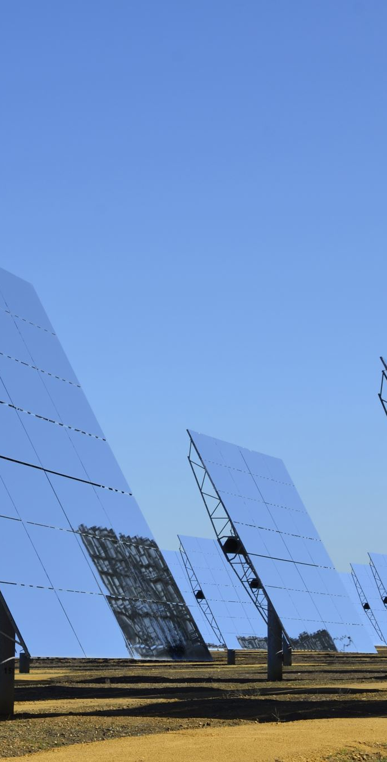
Solar Power Forecasting Using Machine Learning
Name: Adavi Uma Chandra Sekhar
Student ID: 23095401
Supervisor: Pedro Carrilho

Slide 2
Aim of the Work
• Forecast solar power generation using machine learning techniques
• Analyze patterns in solar energy data
• Build and evaluate predictive models

Slide 3
Dataset
• Contains solar energy production readings
• Includes weather, time-based, and production variables
• Used for preprocessing, model training, and evaluation

Slide 4
Motivation
• Solar power is inconsistent and dependent on weather
• Forecasting helps improve grid stability and planning
• Supports renewable energy integration

Slide 5
Methodology
• Data Preprocessing
• Exploratory Data Analysis (EDA)
• Feature Engineering
• Machine Learning Model Training
• Model Testing and Evaluation

Slide 6

Confusion Matrix
• Confusion matrix used for classification model evaluation
• Shows true positives, true negatives, false positives, false negatives
• Helps measure accuracy, precision, recall

Slide 7
Results
• Visualizations include production trends, correlations, predictions
• ML model performance summarized
• Accuracy metrics indicate forecasting reliability

Slide 8
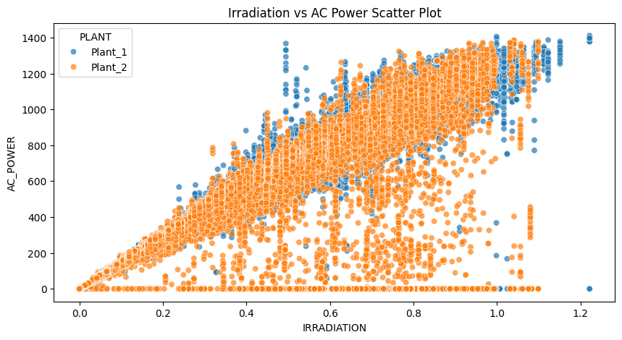
Scatter Plot: Irradiation vs AC Power

Slide 9
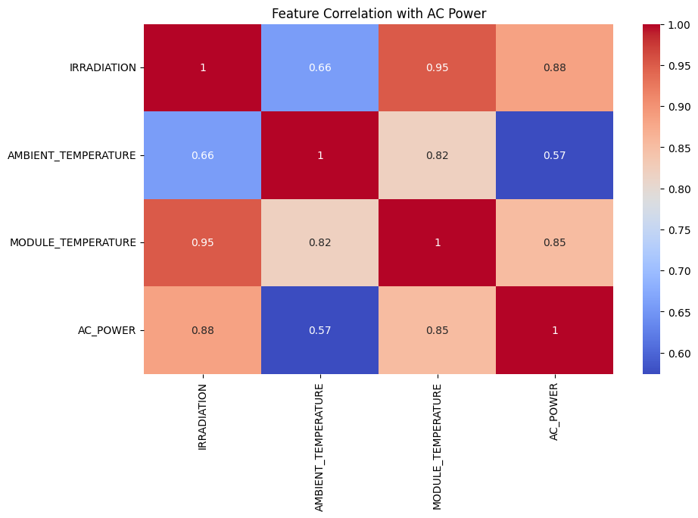
Correlation with ac power

Slide 10
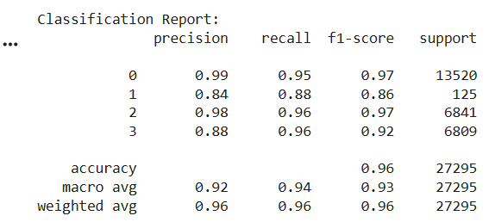
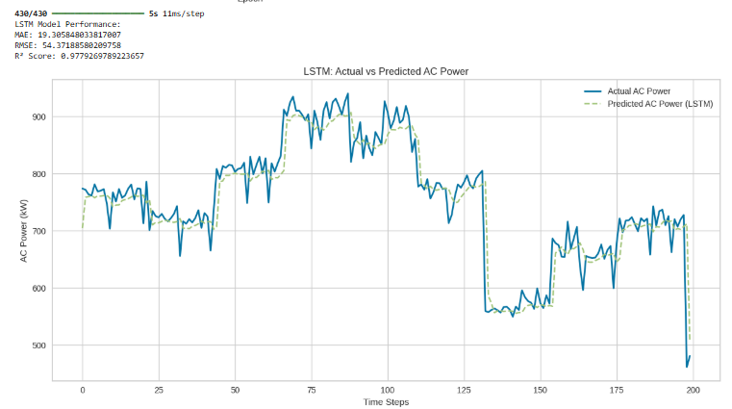

Slide 11
Conclusion
• Machine learning can effectively forecast solar power production
• Improves planning and enhances renewable energy utilization
• Future work: Deep learning, larger datasets, real‑time prediction

Slide 12
References
•Antonanzas, J., Osorio, N., Escobar, R., Urraca, R., Martinez-de-Pison, F. and Antonanzas-Torres, F., 2016. Review of photovoltaic power forecasting. Solar Energy, 136, pp.78-111.
Voyant, C., Notton, G., Kalogirou, S., Nivet, M.L., Fouilloy, A., Motte, F. and Voyant, P., 2017. Machine learning methods for solar radiation forecasting: A review. Renewable Energy, 105, pp.569-582.
Wan, C., Zhao, J., Song, Y., Xu, Z., Lin, J. and Hu, Z., 2015. Photovoltaic and solar power forecasting for smart grid energy management. CSEE Journal of Power and Energy Systems, 1(4), pp.38-46.

Slide 13

Thank You
Thank you!
Questions are welcome.

